Slide 1
Operationalizing One Health: The Bangladesh Experience
Nitish Debnath, DVM, PhD
&
Mushtuq Husain, MBBS, PhD
FAO-AI Unit-DLS & IEDCR

Slide 2
Operationalization of One Health
Communication, Advocacy , Networking & leadership
Need Assessment & Capacity Development
Research Collaboration
Educational & Training
Collaborative Practices

Slide 3
Progression of One Health in Bangladesh
Informal discussion began at Chittagong Veterinary Animal Sciences University (CVASU) in 2007 at the emergence of HPAI
Looking for relevant partners to move forward.
IEDCR and ICDDR,B showed keen interest as human health partners.
Positive responses from professionals working in Livestock, Agriculture and Forestry sector.
Civil society-BAPA, NGO-BRAC, Academia-BAU, DU & BSMRMU and Research-BLRI, IFRB etc. got involved

Slide 4
Formation of One Health Bangladesh
Representatives from 12 national and international organizations got together to form a professional organization called One Health Bangladesh in December 2007.
Formed a National Coordination Committee to work for promoting One Health concept in Bangladesh.
Membership criteria: Physicians, vets, agriculturists, environmentalists, wildlife experts, ecologists, anthropologists, economists, allied scientists and practitioners, activists.
Currently 200 active members.

Slide 5
One Health Bangladesh: A New Professional Movement
One Health Bangladesh emerged as professional body:
Adopted a constitution and Chittagong Declaration to project its vision for Bangladesh
Bringing diverse professionals together to promote health and welfare of all species
Initiate a new culture of cross-professional work, dialogue, collaboration and integration
Promote One Health advocacy and connectivity:
Organizing seminar, conference, consultation
Disseminating one health success stories to a wide-ranging audience.
National, regional and global Networking
Advocate and garner Govt. support for One Health
Promote One Health through existing programmes

Slide 6
Advocacy and Communication
CVASU & One Health Bangladesh had three conferences jointly:
Change towards One World One Health-2008
One Health Approach for Attaining Food Security-2009
Networking for promoting change towards One Health-2010
ICDDR,B and One Health Bangladesh had three joint conferences:
One Health Approach for Controlling HPAI and other EIDs-2008
One Health Approach for Outbreak Investigations-2009
Networking for One Health in South Asia-2010
Complementary meetings, seminars and workshops on putting One Health to work at IEDCR.
IEDCR works as Secretariat of One Health Bangladesh

Slide 7
One Health: Research
Emerging Pandemic Threats
5 year, USAID-funded project
Builds upon USAID/USG investments in avian and pandemic influenza preparedness and response
Expands efforts to address emerging zoonotic infections more generally, especially those of wildlife origin
Vets, physicians and wildlife experts are undertaking collaborative research on EIDs
Actively involved with OHASA
7

Slide 8
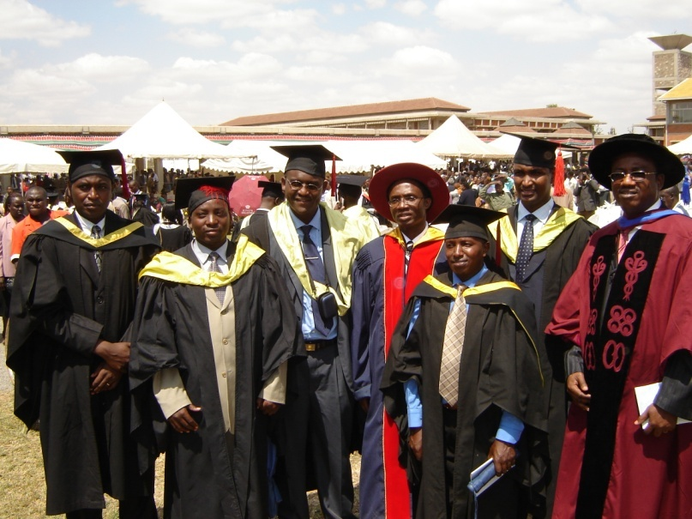
Field Epidemiology Training Program
Modeled after CDC’s Epidemic Intelligence Service
Two-year, full-time postgraduate training program
Closely supervised, on-the-job, competency-based training
About 25% class work, 75% field placement
Trainees assigned to positions that provide epidemiologic service to human health and animal health
Trainees will be physicians, vets and wildlife experts
Notes:
FETPs or Field Epidemiology Training Programs are our most well-known applied epidemiology programs. They were developed in response to country requests for programs like the U.S. Epidemic Intelligence Service (EIS)
The program is a 2-year, full time training program with approximately 25% of the time spent in classroom instruction & 75% in field assignments. The training is competency based with close supervision, with courses in epidemiology, surveillance, biostatistics, and related topics. The trainees provide epidemiologic services to the ministry of health during their training including surveillance system assessments & outbreak investigations.
We also work with other programs at CDC to provide technical assistance in surveillance system development or strengthening, with the activities tailored to the priorities of the country.
Graduates receive a certificate or, in some programs, a degree. The trainees are employees of the ministry of health, and most of the graduates stay in the ministry of health (about 80%) and many of the graduates are now in leadership positions within the ministry.

Slide 9
SAVE-Network
CVASU organized a regional workshop of South Asian Vet. Schools in September 2010 to create South Asian Veterinary Education Network(SAVE).
Founding members: Five Vet. Schools of Bangladesh, two from India, one from Nepal, two from Pakistan and one from Srilanka.
Developing thinking and practices in South Asia in relation to One Health through SAVE.
Embedding One Health in Veterinary Curriculum through SAVE

Slide 10
Outbreak Investigation & Response
Avian influenza
Nipah virus
Anthrax
Rabies

Slide 11



A collaborative investigation team
Department of Livestock Services
Institute of Epidemiology, Disease Control and Research (IEDCR
ICDDR,B
FAO AI Technical Unit
Epidemiologists
Clinicians
Veterinarians
Anthropologists

Slide 12
Joint Outbreak Investigation
Multidisciplinary team visiting outbreak sites
Joint Reporting & Consultation
Share laboratory findings
Joint response to national EID outbreaks
A new professional culture emerging

Slide 13
Progression of Joint Activities
Before
H5N1
Since
H5N1
Other
zoonoses
Zoonoses
H5N1
Communication
-
+++
+/-
Coordination
-
++
+/-
Collaboration
+/-
++
+
_
_
_
Integration

Slide 14
Challenges for all One Health Proponents
As an emerging field, one health is still an amorphous entity, currently in a state of flux.
Agreement is yet to emerge which underpin its educational and research base.
It is yet to fix the relationship between the different disciplines which inform its knowledge base.
Collaborative practices are still evolving and doing so at different rates, in varying ways in different parts of the world.

Slide 15
Difficulties with diverse teams
Dissent and disagreement arouse negative feelings
Diverse teams have less cohesion and longevity
Social networks tend to be homogenous

Slide 16
Professional and Institutional Barriers
Different Ministries
  Ministry of Health and Family Welfare
  Ministry of Fisheries and Livestock
  Ministry of Agriculture
  Ministry of Environment and Forests
Different objectives
Different lines of authority
Different professional backgrounds
  Separate personal backgrounds

Slide 17
Institutionalization
Political will and commitment
Proof of success
Economic benefit
Cultural Change

Slide 18
Challenges for Bangladesh
Highest population density in the world
Hot spots for EIDs and Re-emerging diseases
Vulnerable food security and safety
Most fragile ecosystems
50% of the tube wells exceed WHO standard for arsenic
People are exceptionally close to animal

Slide 19
Nature of the Problems
Global
Health of human, animal & environment is inextricably linked
Multidisciplinary & Multisectoral
Requires new skill, competence, knowledge & work culture
A shift of paradigm?
One Health- a new way forward

Slide 20
Albert Einstein Once Said:
“We can’t solve problems using the same kind of thinking we used when we created them.”

Slide 21
Thanks for you patience!

Slide 22
Acknowledgements
Mat Yamage, FAO AI Tehnical Unit
Steve Luby, ICDDR,B
M . Rahman, IEDCR
Abul Kalam, DLS
Marjina and Shaneaz, CVASU

